Slide 1
Prevention of Sexual Harassment
At
The Workplace
By: Ms. Niharika Bora
Asst. Manager (HR/Welfare)

Slide 2
Sexual Harassment is not…
A “women’s thing”
A passing fad
Something to joke about
Something to be ignored
A cause for paranoia and fear
It’s a legal requirement to prevent, prohibit and address this issue at “Workplace”

Slide 3
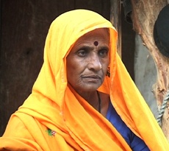
Bhanwari Devi
Indian Dalit Woman
Village Bhateri, Rajasthan
Winner of “Neerja Bhanot Memorial Award” for her "extraordinary courage, conviction and commitment
HER STORY
“Bhanwari Devi continues to be ostracized by her village. She lives on the outskirts of the village Bhateri, just 55 kms from Jaipur, with her husband who’s supported her fight throughout. She now runs a self help group with other women from her community and works with an NGO to support her family.”

Slide 4
Vishakha Guidelines
Supreme Court of India Judgement 1997
(Ref: Vishakha and Ors. V State of Rajasthan)
“In the absence of enacted law to provide for the effective enforcement of the basic human right of gender equality and guarantee against sexual harassment and abuse, we lay down the guidelines and norms specified hereinafter for due observance at all work places or other institutions, until a legislation is enacted for this purpose. …and it is further emphasised that this would be treated as the law declared by this Court under Art. 141 of the Constitution.”
The judgment of August 1997 provided the basic definitions of Sexual Harrasment at the workplace and provided guidelines to deal with it. It is seen as a significant legal victory for women's groups in India
Estalished that “Sexual Harassment violates a woman’s right in the workplace and is thus not just a matter of personal injury”
Notes:
Right to life means life with dignity. Gender equality includes protection from sexual harassment and right to work with dignity, which is a universally recognised basic human right.
In the absence of enacted law, the Supreme Court in the Vishaka judgement (1997) has laid down the guidelines and norms for compliance at all work places/institutions. Under article 141 of the Constitution, these guidelines and norms of the Supreme Court are required to be treated as THE LAW OF THE LAND.

Slide 5
ADVENT OF LAW
  By adopting the Vishakha Guidelines and recommendations of Justice Verma Committee, the Parliament enacted the Sexual Harassment of Women at Workplace (Prevention, Prohibition and Redressal) Act in 2013 read with The Sexual Harassment of Women at Workplace (Prevention, Prohibition and Redressal) Rules, 2013
  (effective Dec 2013)
  This statute supersedes the Vishakha Guidelines for prevention of sexual harassment introduced by the Supreme Court of India.
  The Statute extends to the “Whole of India”
  It is only for the protection of “Women at Workplace”

Slide 6
Preamble
An Act to provide protection against sexual harassment of women at workplace and for the prevention and redressal of complaints of sexual harassment and for matters connected therewith or incidental thereto.

Slide 7
Sexual
Harassment

Slide 8
AGGRIEVED WOMAN
In relation to a workplace, a women, of any age whether_
  Regular employee
  Temporary employee
  Adhoc
  Daily wages or not , who alleges to have been subjected to any act of Sexual harassment by the respondent

Slide 9
Sexual Harrassment
Sexual harassment is bullying or coercian of a sexual nature, or the unwelcome or inappropriate promise of rewards in exchange for sexual favors. In most modern legal contexts, sexual harassment is illegal.
Sexual harassment is gross violation of women’s right to equality and dignity

Slide 10

SEXUAL HARASSMENT
(Sec 2(n) of the Act)
Sexual Harassment includes any one or more of the following unwelcome acts or behavior (whether directly or by implication) namely :
  physical contact and advances; or
  a demand or request for sexual favour;
  or
  sexually colored remarks; or
  showing pornography; or
  other offensive or derogatory pictures, cartoons; or
  any other unwelcome physical, verbal or non-verbal conduct of sexual nature.

Slide 11

Sexual Advances

Slide 12

Unsavoury remarks

Slide 13

Jokes causing or likely to cause awkwardness or embarrassment

Slide 14

Unwelcome sexual overtones in any manner

Slide 15
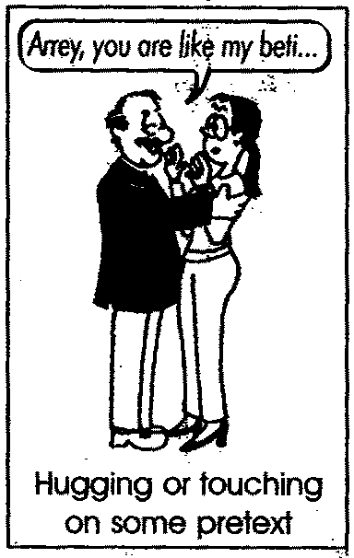
Touching or brushing against any part of the body and the like

Slide 16

Displaying pornographic or other offensive or derogatory pictures, cartoons, pamphlets or sayings

Slide 17

Forcible physical touch or molestation

Slide 18
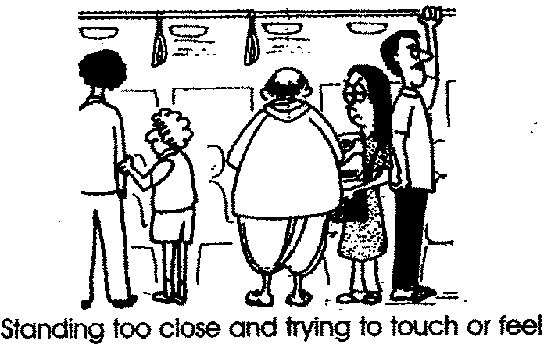
Physical confinement against one’s will and any other act likely to violate one’s privacy

Slide 19
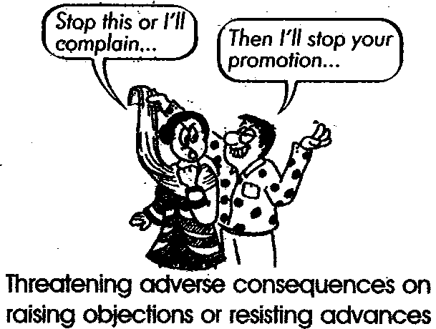
Abuse of authority or power

Slide 20
Workplace Sexual Harassment
typically involves acts of which the victim has reasonable apprehension that they are
  Humiliating
  Unsafe
  Unhealthy
  Discriminatory
  Career limiting
  Otherwise causing adverse circumstances

Slide 21
Few provisions of the IPC
354. Assault or criminal force to woman with intent to outrage her modesty.
Whoever assaults or uses criminal force to any woman, intending to outrage or knowing it to be likely that he will thereby outrage her modesty, shall be punished with imprisonment of either description for a term which may extend to two years, or with fine, or with both

Slide 22
Sexual Harrassment under Sec 354 A of the Indian Penal Code
Physical contact and advances involving unwelcome and explicit sexual overtures or
A demand of request for sexual favours or
Showing pornography against the will of a woman or
Making sexually coloured remarks
Imprisonment for upto 5 years or fine or both

Slide 23
Internal Complaints Committee (constituted through a written order)
50% shall always be women
Chairman | Women Working at senior level as employee;
2 members | From amongst the employees committed to the cause of women/ having legal knowledge/experience in social work
Member | From amongst NGO/ associations committed to the cause of women or a person familiar with the issue of sexual harassment
If a offices are located at different palces, each place needs
to have an ICC

Slide 24
Local Complaints Committee (constituted by District Officer)
50% shall always be women
Chairman | Eminent Women in the field of social work and committed to the cause of women
Member | Nominated from among the women working in the block, tehsil or ward
2 members | From amongst the employees committed to the cause of women/ having legal knowledge/experience in social work
Ex Offio Member | The concerned officer dealing with social welfare of women and child developmen n the district

Slide 25
Duties of employer
Every employer shall--
Provide a safe working environment at the workplace which shall include safety from the persons coming into contact at the workplace;
Display at any conspicuous place in the workplace, the penal consequences of sexual harassments: and the order constituting, the Internal Committee under this law;
Organize workshops and awareness programmes at regular intervals for sensitizing the employees with the provisions of the Act and orientation programmes for the members of the Internal Committee in the manner as may be prescribed;
Provide necessary facilities to the Internal Committee or the Local Committee, as the case may be, for dealing with the complaint and conducting an inquiry;

Slide 26
Duties of employer
(d) Provide assistance to the woman if she so chooses to file a complaint in relation to the offence under the Indian Penal Code(45 of 1860) or any other law for the time being in force;
(e) Treat sexual harassment as a misconduct under the service rules and initiate action for such misconduct;
(f) Monitor the timely submission of reports by the Internal Committee

Slide 27
It is the Employer’s responsibility to…
prevent or deter the committing of any act of Sexual Harassment by means of
  Creation of appropriate working conditions
  Ensuring female employees are not treated as sex objects
  Ensuring that no male employee or third party will outrage or insult the modesty of a female colleague
  Ensuring that no male employee or third party will make any type of sexual advances to female colleagues
  Establishment of a Complaints Committee

Slide 28
Complaint Committee should
Be thoroughly prepared
Know the Act, Policy and/or relevant Service Rules
Gather and record all relevant information
Determine the main issues in the complaint
Prepare relevant interview questions
Conduct necessary interviews
Ensure parties are made aware of the process and their rights/responsibilities within it
Analyse information gathered
Prepare the report with findings/recommendations
Maintain Confidentiality

Slide 29

Education and Awareness is the key

Slide 30
Policy
Employer shall create a policy which
  Prohibits sexual harassment at workplace
  Provides a detailed framework for the redressal of complaint
Policy to be Communicated

Slide 31
Communication
Carry out awareness and orientation for all employees
Create forums for dialogue
Ensure capacity and skill building for the Complaints Committee
Widely publicize the names and contact details of members of Complaints Committee

Slide 32
The Complaint mechanism
Any aggrieved woman may make, in writing, a complaint of sexual harassment at workplace to the Complaints Committee, within a period of three months from the date of incident and in case of a series of incidents, within a period of three months from the date of last incident.
The time limit may be extended for another three months if the CC is satisfied with the reasons for non non-filing
If woman is unable to make a complaint in writing, CC to provide assistance

Slide 33
Who can make the complaint
The woman herself
In case of mental incapacity
  Her relative
  Friend
  Special educator
  Qualified psychiatrist/ psychologist
  Guardian under whom she is receiving care
  Any person who has information about incident with written consent of any of the above

Slide 34
Who can make the complaint
In case of Physical incapacity
  Her relative
  Friend
  Co-worker
  Officer of the National / State commission for women
  Any person who has information about incident with the written consent of woman
  In case of death any person who has information about incident with the written consent of legal heir
  In any other case, by any person Any person who has information about incident with the written consent of woman
is unable to make complaint due to death or physically or mentally incapacity, her legal heir or a person authorised by her may make the complaint

Slide 35
The Complaint
The complaint (six copies) by the aggrieved person should contain all the material and relevant details concerning the alleged sexual harassment which includes
  the name of contravener
  the complainant
  Date
  Time
  Location
  Working Relationship between parties
  Names and addresses of witnesses, if any

Slide 36
The Complaint mechanism
On receiving such a complaint, the chairperson will inform other members of Committee at the earliest possible and Committee will take further steps in the matter as required. The first meeting is to be held immediately within reasonable time but not later than 07 working days of receiving the written complaint of the Aggrieved .
The ICC shall investigate the Complaint and submit its Report containing the findings/ recommendations along with relevant documents
In conducting inquiry, a minimum of three members of CC including chairperson to be present

Slide 37
Upon Receipt of Complaint
Review the Complaint to ensure
  It has all the information
  The conduct of respondent was towards complainant and
  is improper and may form SH at Workplace
  The incident occurred in workplace or at any location/any event related to work
Send complaint to Respondent within seven days of receipt to respond within 10 days
Meet up with complainant for any settlement/concilliation

Slide 38
Conciliation

Slide 39
Inquiry
Initiate enquiry
Interview the Complainant, Respondent, Witnesses
Listing of the Events
Fact Finding
Confidentiality and Impartiality is the key

Slide 40
Inquiry Process
Follow the Principles of natural Justice
Order Ex-parte or terminate the proceedings if the complainant or Respondent fail to be present for three consecutive hearings
Legal Practitioners are not permitted
Confidentiality to be maintained

Slide 41
Interim Measure
To prevent ongoing SH at the written request of the woman or event otherwise, CC may recommend
  Restrain the respondent from
    reporting on work performance of the Aggrieved woman
    Writing her Confidential Report, appraisal
    Supervising her academic activities
  Transfer the Complainant or Respondent
  Place Complainant or Respondent on Leave

Slide 42
Action during pendency of inquiry

Slide 43
Recommendations
In case allegations are Proven
  Service Rules to be followed as for “misconduct”
  Disciplinary Actions like Written Apology; Warning;
  With-holding of promotion
  With-holding of pay increase or increments
  Counselling Sessions
  Community Service
  Termination from services
  Financial Damages

Slide 44
False or malicious complaint

Slide 45
TIMELINES
Submission of Complaint | Within 3 months of the last incident
Notice to the Respondent | Within 7 days of receiving copy of the complaint
Completion of Inquiry | Within 90 days of complaint
Submission of Report by ICC/LCC to employer/DO | Within 10 days of completion of the inquiry
Implementation of Recommendations | Within 60 days Appeal Within 90 days of the recommendations
Timelines as per the Act

Slide 46
Appeal

Slide 47
summary

Slide 48
Thank you

